Slide 1
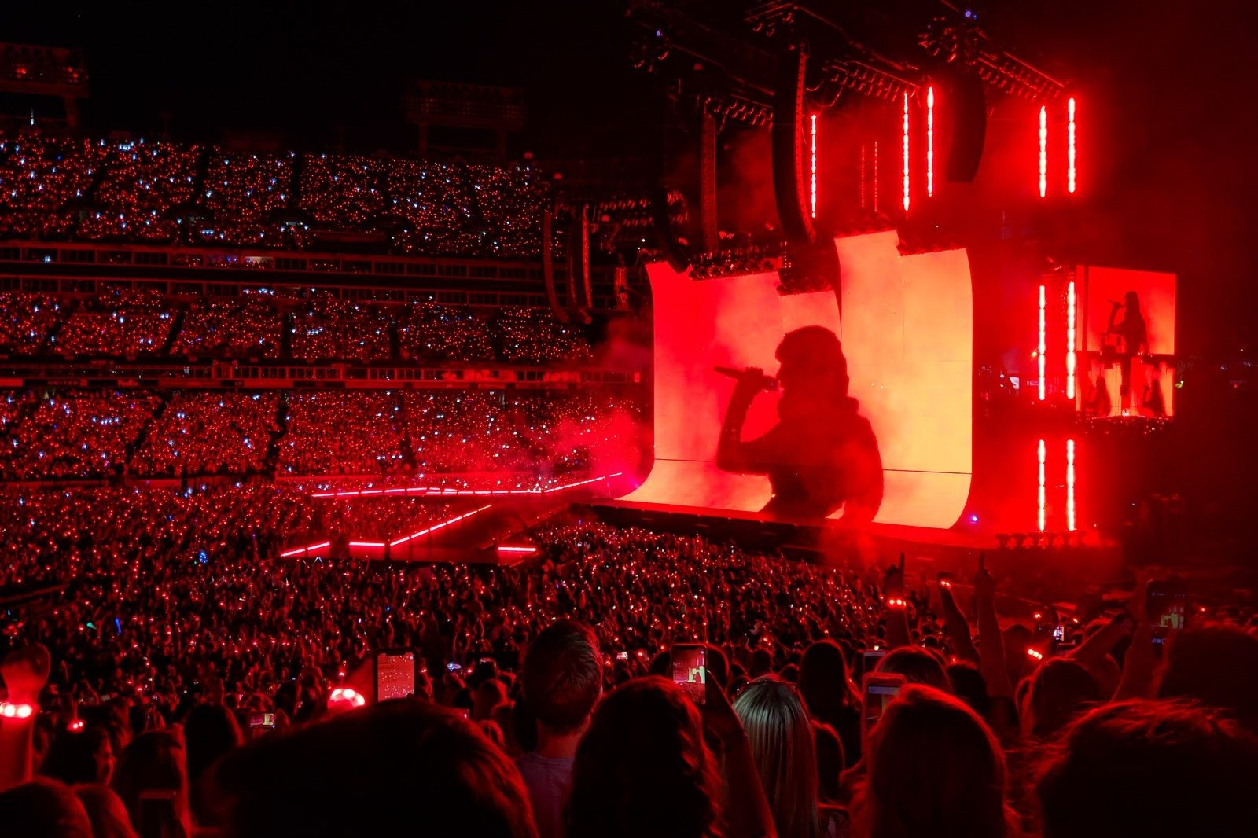

What makes a Song Popular? A Glance into the Music Theory of Taylor Swift
by Dustin Malandra, Wood Walker, Alaina Duquette, Brian Chung & Alison Muller

Slide 2


Questions
Who are the top ten streaming artists of 2023?
What is the streaming activity of Taylor Swift in 2023?
Does musical valence influence the popularity of a song?
Is there a correlation between valence and energy that influences song popularity?
How does Taylor compare?

Slide 3
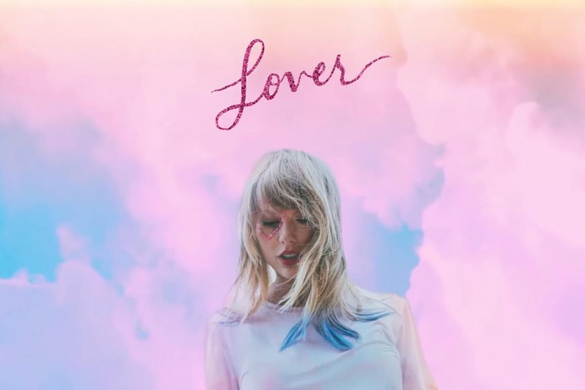
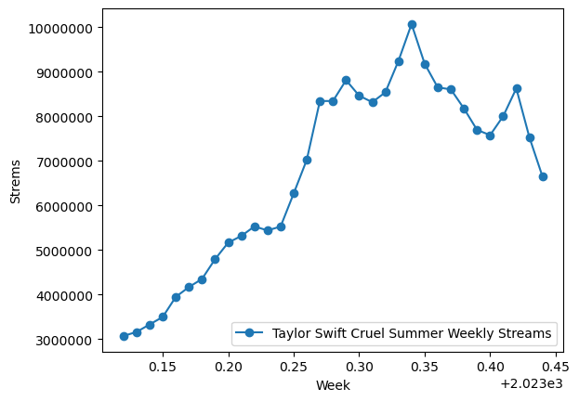
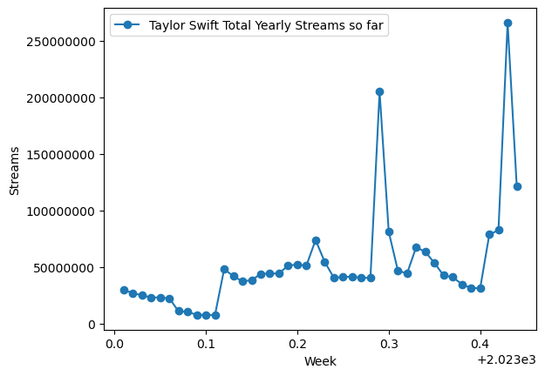
2023 Weekly Streaming of Taylor Swift

Slide 4
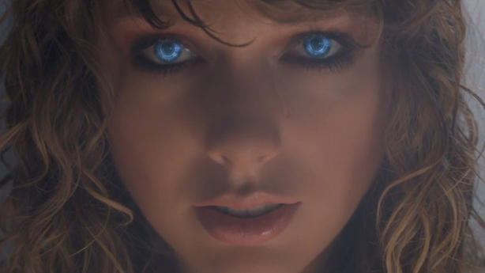
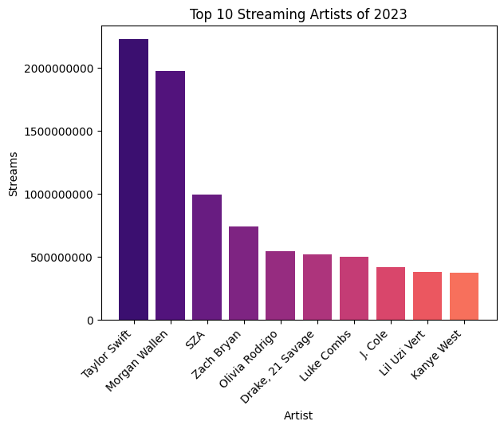
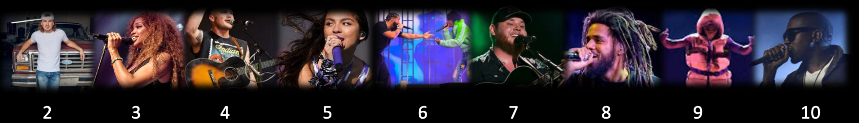
Top 10 Streaming Artists of 2023

Slide 5

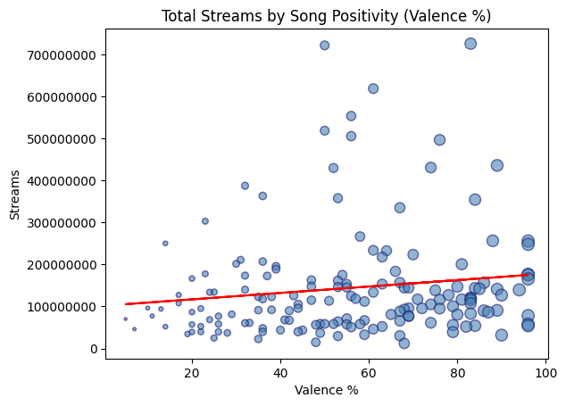
Song streaming does not appear to be influenced by positivity (r-value = 0.14), as the majority of streams
remain below 200,000,000 regardless of valence percentage.

Slide 6
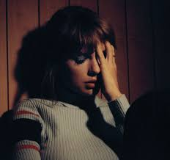
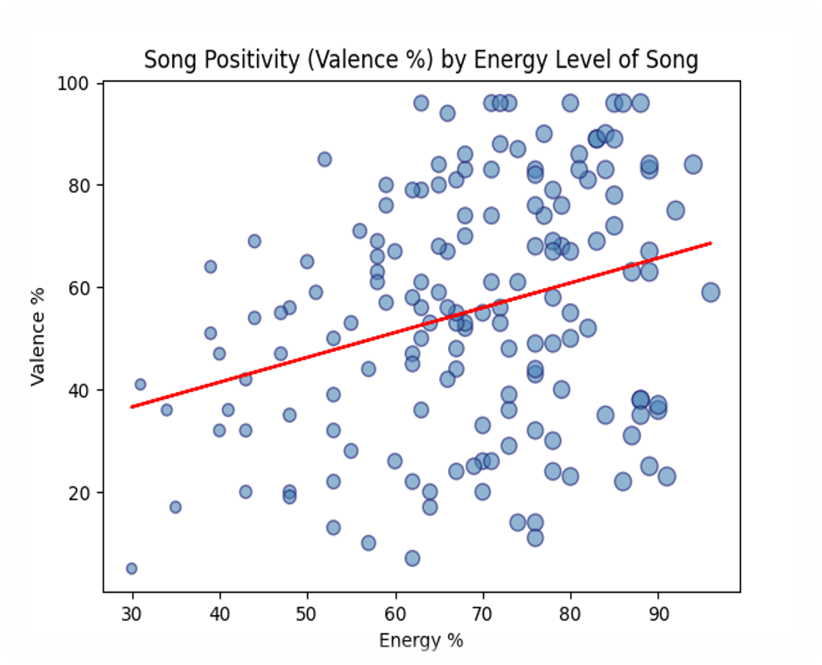
The data shows a weak positive correlation between energy and valence (r-value = 0.29). Songs of high energy are ​​just as likely to influence valence as songs with low energy.

Slide 7
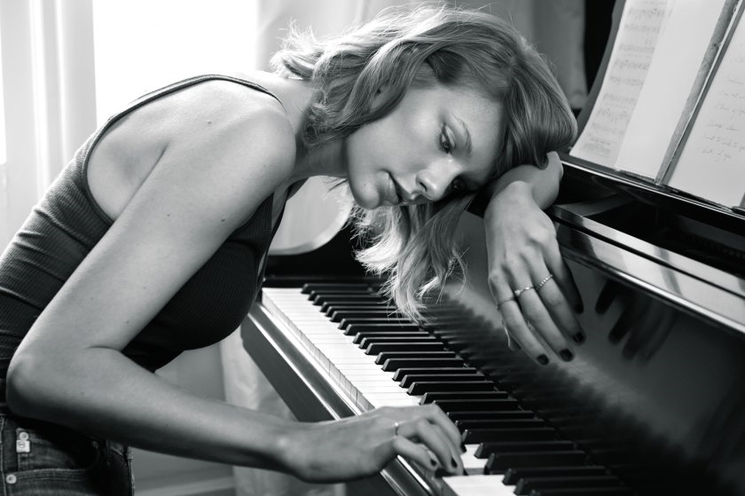
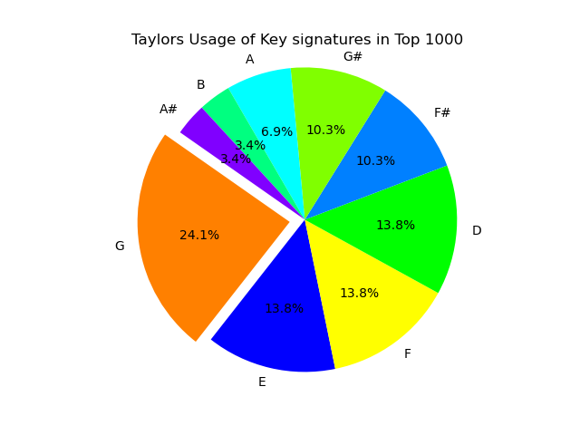
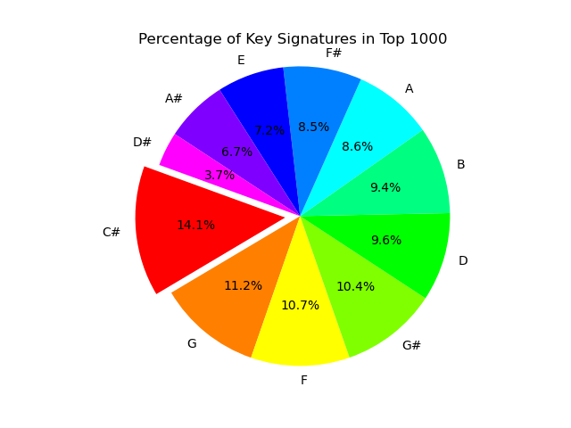
What the G?

Slide 8

We're not out of the woods yet...​
...Music evokes a multifaceted sensory response through sight, sound & movement. Further analysis targeting these sensory influences may advance the predictability of song popularity.

